Slide 1

Regrowing Strategies for Dynamic Sparse Training
Harmen Scholte

Slide 2
Timeline
Introduction
Existing approaches
New regrowing strategies
Methodology
Results
Conclusions

Slide 3
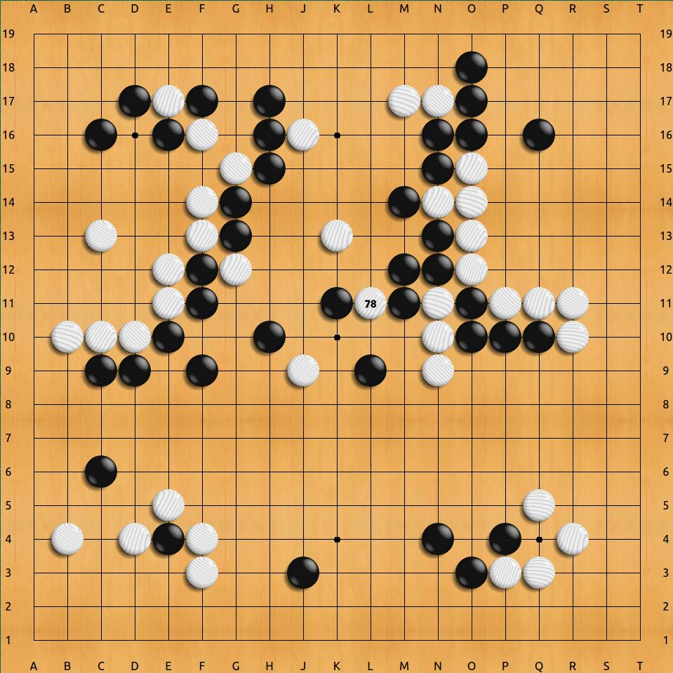
1. Introduction
Deep learning → state-of-the-art results
Very large artificial neural networks
High training times & computation costs
Pruning
Sparse training
Notes:
Deep learning yields currently the most practical results in the field of machine learning, however, it uses very large artificial neural networks, which leads to high training times and computation costs.
To improve scalability, researchers developed strategies for making neural networks less connected, called sparse neural networks.
Sparse evolutionary theory introduced the concept of dynamic sparse training,

Slide 4
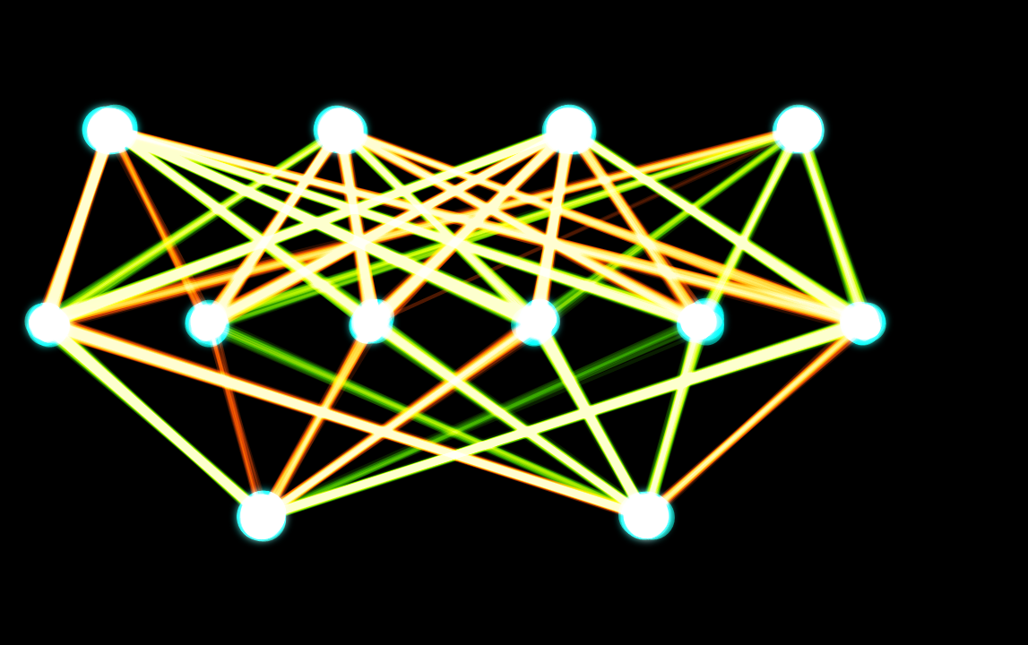
2. Existing approaches
Static sparse training
Dynamic sparse training
  Initialization
  Weight removal
  Weight regrowth
Sparse evolutionary training (SET)
Adaptive performance-based connectivity of SET (AccSET)

Slide 5
2. Existing approaches
Static sparse training
Dynamic sparse training
  Initialization
  Weight removal
  Weight regrowth
Sparse evolutionary training (SET)
Adaptive performance-based connectivity of SET (AccSET)

Slide 6
3. New regrowing strategies
Which connections should be regrown?
On what performance metric should we base connectivity?
What value does alternating between static and dynamic sparse training have?

Slide 7
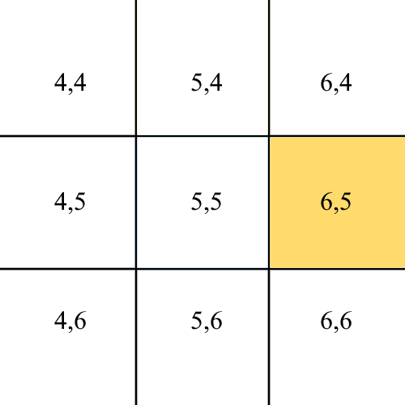
3.1 Which connections should be regrown
SET and AccSET regrow random connections
New methods:
  Random, but “At least one activated neighbour”
  “Regrow by most activated neighbours”

Slide 8
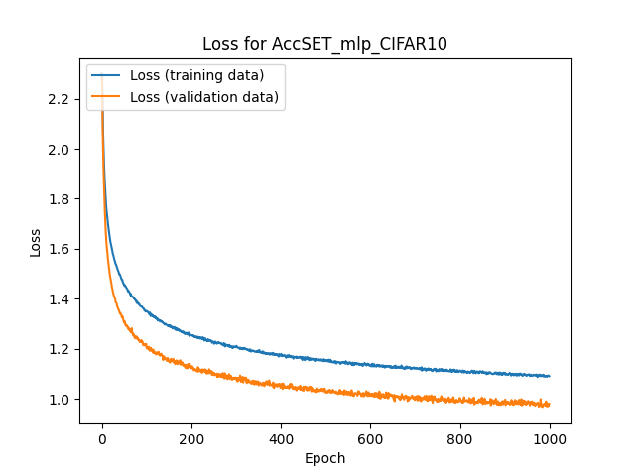
3.2 Performance metrics for connectivity
Base amount of regrows on performance
Accuracy (AccSET)
Loss (LSET)

Slide 9
3.3 Alternating between static and dynamic sparse training
Dynamic sparse training simulates mutation
What if the wrong mutations are made?
Switch to static sparse training if performance decreases
Switch back if performance increases again

Slide 10
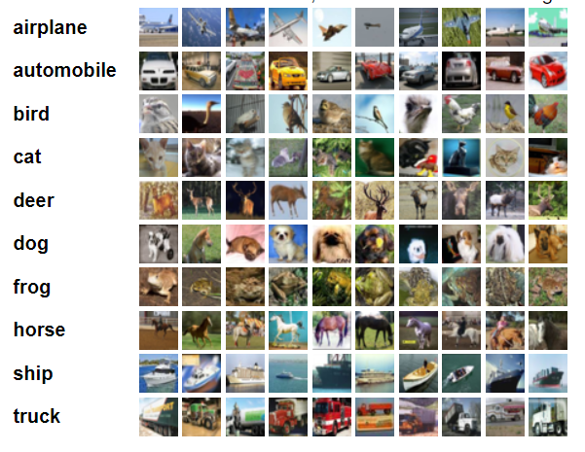
4. Methodology
Multi-layer perceptron
CIFAR-10 (image classification problem)
  60.000 images on 10 classes
SET
  Tensorflow & Keras
  Binary mask

Slide 11
5. Results

Slide 12
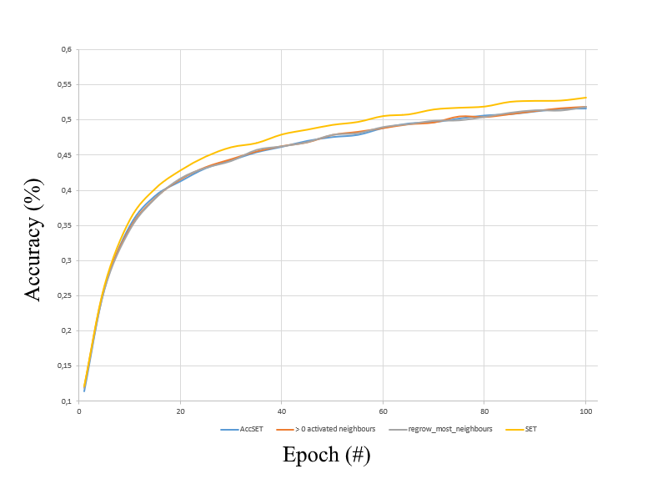

Slide 13
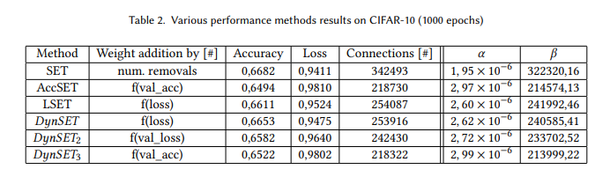

Slide 14
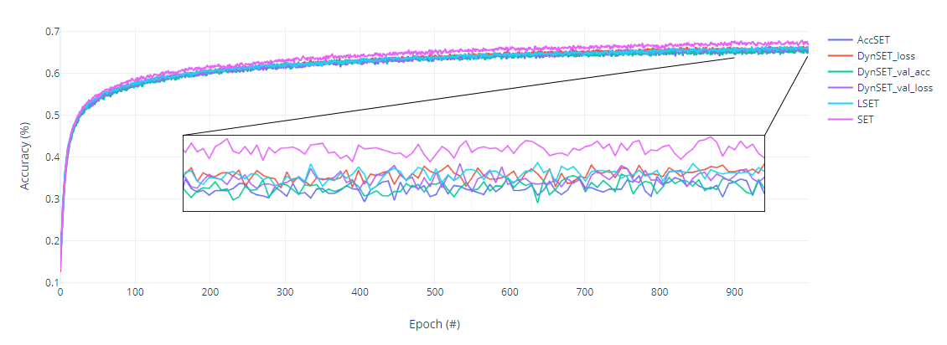

Slide 15
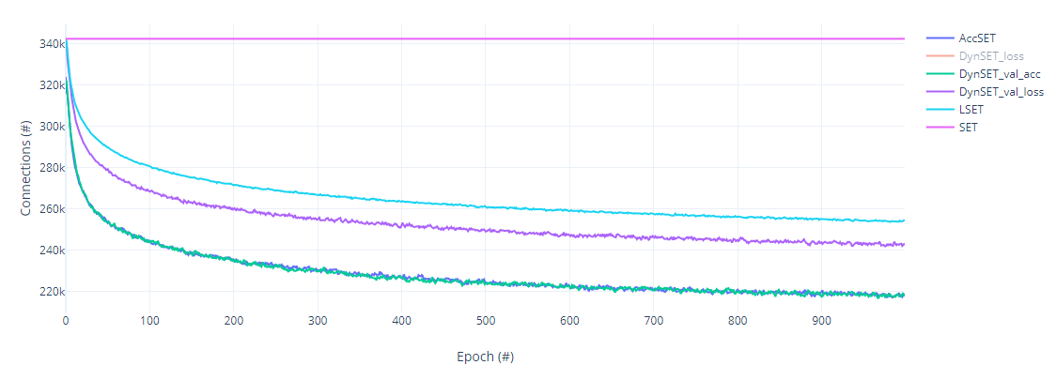

Slide 16
6. Conclusions
Which connections should be regrown?
On what performance metric should we base connectivity?
What value does alternating between static and dynamic sparse training have?
Local activity does not improve performance
loss shows best performance, accuracy shows best relative performance
Alternating shows small systematic improvement on “only dynamic methods”

Slide 17
Regrowing Strategies for Dynamic Sparse Training
Are there any questions?

